Slide 1
Forecasting Energy Consumption via LSTM

Slide 2
Objective
This project aims to predict the electricity load consumption via using LSTM recurrent neural network

Slide 3
Dataset
One is Brazil yearly energy consumption from Kaggle
The second one is 2016Toronto hourly energy consumption

Slide 4
LSTM
Long short-term memory (LSTM) is an artificial recurrent neural network (RNN) architecture used in the field of deep learning. Unlike standard feedforward neural networks

Slide 5
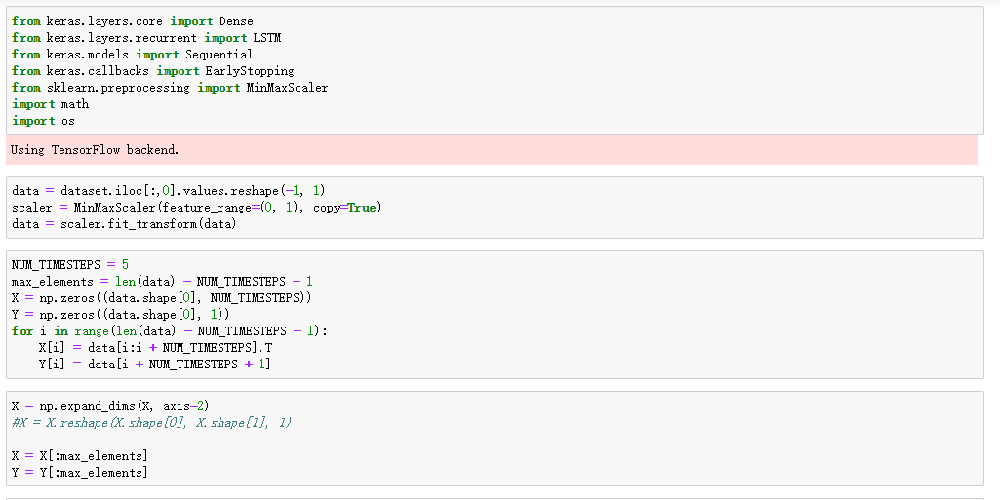
Building Yearly Model
Building yearly model in Python

Slide 6
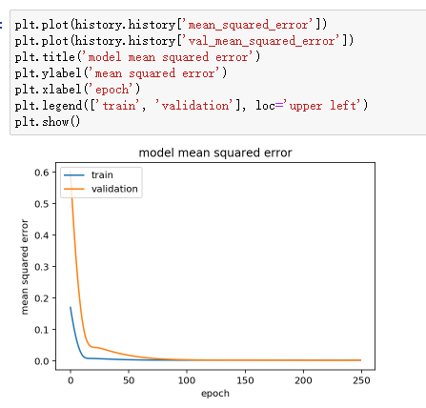
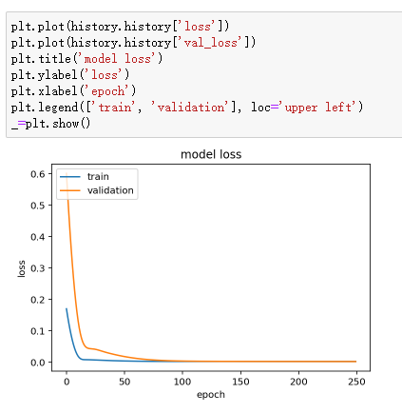
Building Yearly Model
Summarize history for accuracy

Slide 7
Building Yearly Model
The model learns well. It is not overfitting as loss is small for training and validation data.

Slide 8
Forecasting
Use the model and the last NUM_TIMESTEPS training points (the 5 last years of the training set) to forecast next years. We will add each forecasted output to the input sequence and, by this way, we will obtain new forecasts successively for next years. We are going to compare our predictions for the next 5 years with the real data calculating the RMSE metric.

Slide 9
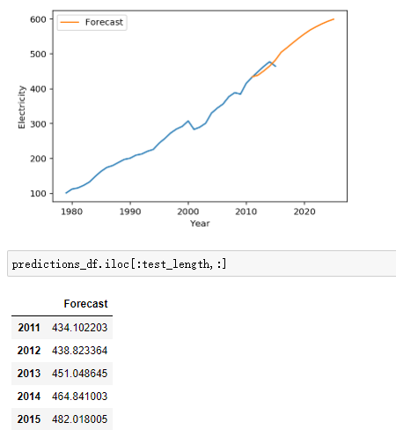
Output

Slide 10
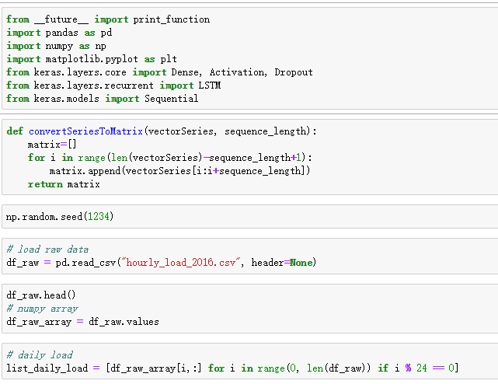
Build hourly model

Slide 11
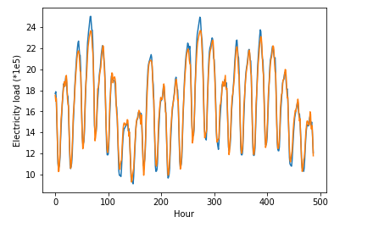
Output

Slide 12
Conclusion
I have built a stateless LSTM deep learning model which works really well: it gets better results than classic time series model like ARIMA

